Slide 1
Chapter 12
Review

Slide 2
Attribution
What is attribution?
Internal attribution- due to a person’s characteristics
External attribution- due to situational variables

Slide 3
Four Types of Attributional Error
Fundamental attribution error
Ultimate attribution error
Actor-observer effect
Self-serving bias

Slide 4
Cognitive Dissonance Theory
Behavior-attitude inconsistency causes distress
Possible threat to positive self-concept
Dissonance reduction comes from changing attitudes
Easier than changing behaviors

Slide 5
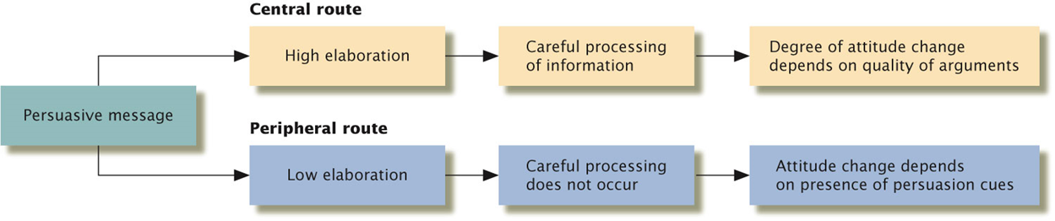
The Elaboration Likelihood Model
Two routes to attitude change
Peripheral route (persuasion cues)
Central route (quality of arguments)

Slide 6
Yale Attitude Change Approach
What factors influence the persuasiveness of a message?
Source of the message | Content of the message | Characteristics of the audience
Credibility of the speaker | Subtlety (being important but not obvious) | attention
Physical attractiveness of the speaker | Sidedness (having more than one side) | Self-esteem Intelligence
 | Whether both sides are presented | Age (18-25 more persuadable)

Slide 7
Group Processes
Pitfalls in group processes
Groupthink
Social loafing
What are the causes and how to reduce them?

Slide 8
Classic Social Psychology Experiments
Stanford Prison Experiment
Milgram’s Obedience Experiment
Asch Experiment
Festinger’s Cognitive Dissonance Experiment

Slide 9
Discrimination and Prejudice
What is stereotype, prejudice, and discrimination?
What are some modern types of discrimination?

Slide 10
Interpersonal Attraction
Women: value a partner’s intelligence more, more influenced by potential men’s economic and social status.
Men: physical appearance of a partner tends to be more important to them than to women.

Slide 11
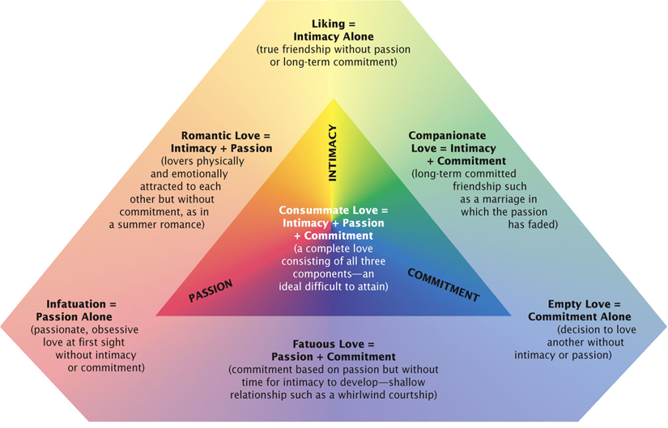
Sternberg’s Triangular Theory of Love
Three components: passion, intimacy, and commitment

